Slide 1
RAMP Website
Commissioner & Manager Guide

Slide 2
Login
Click on ADMIN LOGIN

Slide 3
Login
Enter the Username and Password that was provided. Then click on the blue Login button

Slide 4
Navigating the Dashboard – Entering Rosters
Start by clicking on the “Teams” button. Select “Players” from the dropdown. This will open a new window. Click on either “Add Player” or “Add Multiple Players” to enter your teams roster. Choose your Division and Team from the drop downs. In the first column enter the Jersey Number of the player, in the next column enter their first name and in the third column enter the last name of the player. Continue until all your players are entered. When you are done, scroll to the bottom of the page and click on “Submit”.

Slide 5
Entering Staff Members
Once you have entered your Players, you can continue under Teams and add your Team Staff, if you want to utilize this option. Don’t forget to scroll down to the bottom and click submit when you are done.

Slide 6
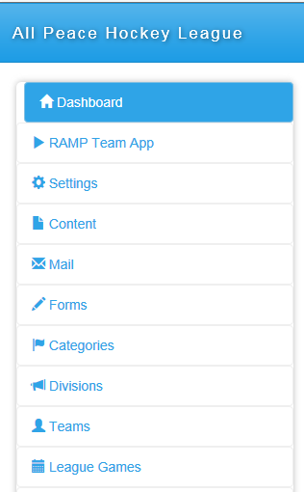
Navigating the Dashboard – Entering Scores
To locate the game you want to update, click on “League Games” from the left menu. Select “League Games” again and the main window will open to the following:
Select your Division and Team from the drop down boxes and click on

Slide 7
Navigating the Dashboard – Entering Scores
Locate your game number
Click on the green button beside the game you want to enter the score for.
A new window will open. Make sure you have the correct game number.
Two fields will have appeared with your team as the Home Score and your opponent as the Visitor Score. Enter the score from the gamesheet.
Click in “Game is Finished” box.

Slide 8
Entering Gamesheet Scores
For exhibition and regular league games, enter the scores and the stats. Having followed the steps up to this point, all you need to do is scroll down and fill in the fields with your information.
Make sure you have saved a copy of the gamesheet and any referee (incident) reports if any to a file location. It can be a PDF or a picture format.

Slide 9
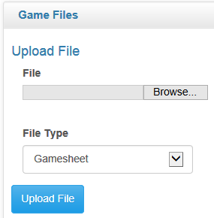
Uploading Gamesheets
Click on “Browse”
Locate the gamesheet file you saved.
Click on Upload File and wait for the gamesheet to electronically attach.
If there are referee reports to attach, follow the same steps but under File Type select Incident Report or Other and click on Upload File
If you choose Other please add an explanation or note.

Slide 10
Uploading Gamesheets
Click on “Submit” once all your information is entered.
Don’t click on the “Verified” button. After your commissioner receives your scoresheet, they will review and click “Verified” to show that they have reviewed your entries.

Slide 11
Questions?
Call Lisa at 780-296-6617 or send an email to lisabur@telus.net if you require any further assistance.

